Slide 1
Advocacy 101 & Beyond
Erika Kelly
Chief Advocacy &Government Affairs Officer
at Meals on Wheels America
Jose Luis Sanchez
Programs & Aging Initiatives Manager
at Citymeals on Wheels

Slide 2
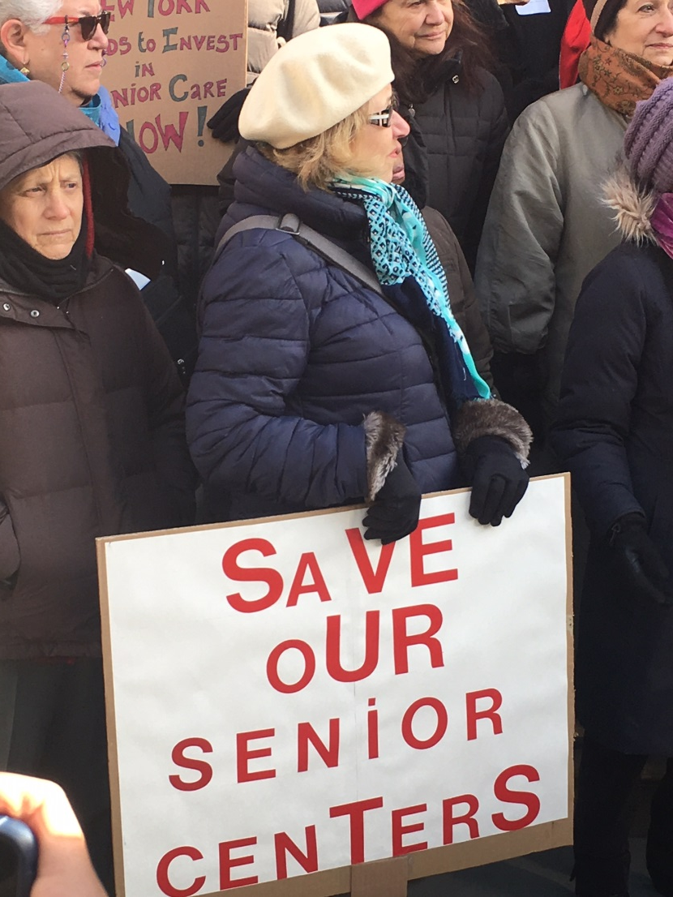
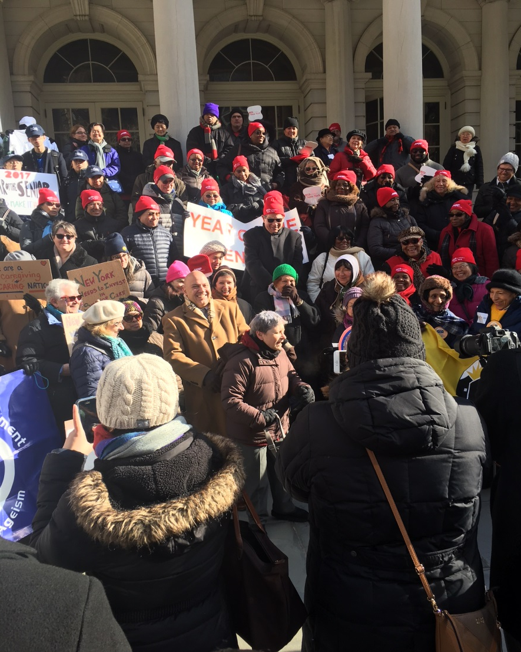
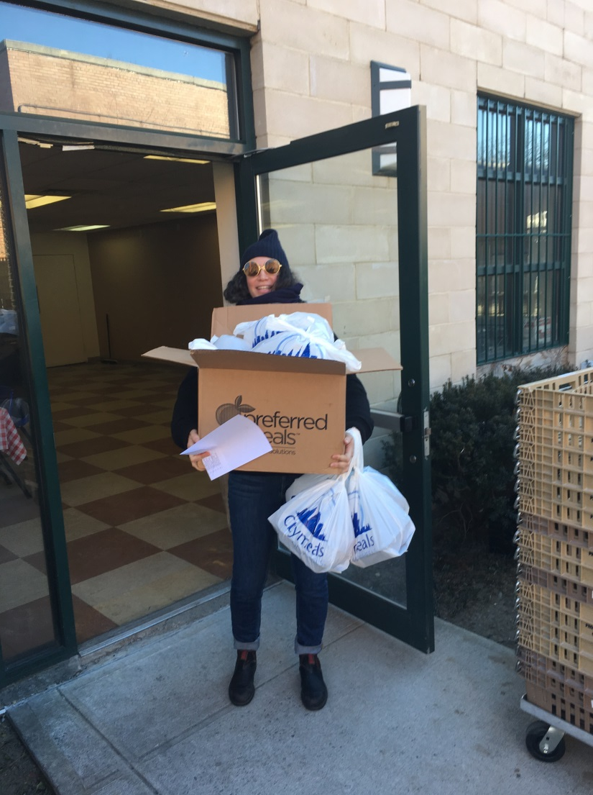

Slide 3
Advocacy is not Agitating
Why to Advocate?
Need better infrastructure
Need better funding
Need better access, education, awareness
Need to get something to better something else
Becoming a voice for those in need

Slide 4
Advocacy
Whatever the specific need; all of us have to advocate on behalf of older adult New Yorkers
Weigh your appetite for risk but do not shy away from asks
Simple asks of local elected officials and councils
From volunteer, corporate and community groups

Slide 5
Advocacy
Communicate your program’s benefits to EVERYONE!!
Empower your program’s consumers; give them ample opportunities to voice their concerns either at public hearings, through letter writing campaigns, or video interview.
Relentless follow up to your targets

Slide 6
Advocacy
Consider your language surrounding “Aging”
Illustrate examples of your work
https://www.citymeals.org/blog-post/aging-coalition-advocates-our-citys-seniors
https://www.citymeals.org/ending-elder-hunger
https://www.facebook.com/Citymeals.on.Wheels/videos/vb.82637311931/10153236277641932/?type=2&theater

Slide 7
Case Study: NYC Aging Coalition
2017 Year of the Senior
Diverse, wide and deep Coalition representative of City’s Aging population
Sought out Elected Officials Champion
Made asks based on fact and consensus agreement of priorities

Slide 8
2017 is the Year of the Senior! Actions:
CALL-Tell them to support additional funding for senior services!
To Call Your Representatives:
In order to have a large volume of calls on a given day, we're asking people to call anytime between 9am and 5pm every Wednesday this month. The more days you can call, the better!
Call the Mayor at: 1-844-617-2691
Call your council member.
Use this script as a guide for your call (and please be polite):
“Hi, my name is [your name], I live in [your borough, or if speaking to a council member, your council district] and I am calling to tell [the mayor or the council member] that the City needs to make seniors a priority. I'm asking that the City invest $60 million this year to increase and improve senior services. The services enable older New Yorkers to stay in their communities with support and dignity.”
[Optional: Let the mayor know that you’ll be voting in November when he is up for re-election!]

Slide 9
Actions
Tweet-Tell them to support additional funding for senior services!
To Tweet at your Representatives:
Amplify your voice by tweeting at the mayor (@NYCMayor), the city council speaker (@MMViverito), and/or your council member. Be sure to use the #YearoftheSenior hashtag!
Sample tweets (adapt tweets above or use these):
· Senior pop grows while funding stagnates @NYCMayor Invest $60M in senior services. #YearoftheSenior
· Older NYers are pillars of our communities. DFTA services help them age in place @NYCMayor invest $60M in DFTA in FY18 #YearoftheSenior
· Sr Centers, NORCs, meal programs etc. need increased investment! #YearoftheSenior

Slide 10
Actions
Stay local-Tell them to support additional funding for senior services! To Ask the Mayor a Question on Brian Lehrer Show:
Tweet @BrianLehrer every Wednesday to get him to ask about city funding for seniors in his weekly #AsktheMayor segment with Mayor de Blasio. Include the #AsktheMayor hashtag in every tweet.
Sample questions and tweets:
#askthemayor how he will fund the growing demand for senior services @BrianLehrer Sr centers, NORCs and other programs need more support
Senior pop grows while funding remains stagnant @BrianLehrer #askthemayor when will he invest in meal services, caregiver programs, etc
2500+ seniors on waitlists for case management or homecare @BrianLehrer #askthemayor why no funds have been added to address demand?
#askthemayor how he will protect older NYers from Trump budget cuts @BrianLehrer
#askthemayor how he will fund programs that serve older immigrants and low-income women? @BrianLehrer

Slide 11
Results: NYC Aging Coalition
On June 6, 2017, the New York City Council voted to pass the Fiscal Year 2018 budget, which includes an historic $22.89 million in permanent funding for senior services.
Notes:
-https://humanservicescouncil.org/wp-content/uploads/NewsArticles/Councilmembers-Chin-Vallone-Rosenthal-Declares-Victory-for-Seniors-and-Human-Services-Organizations.pdf

Slide 12
